Slide 1
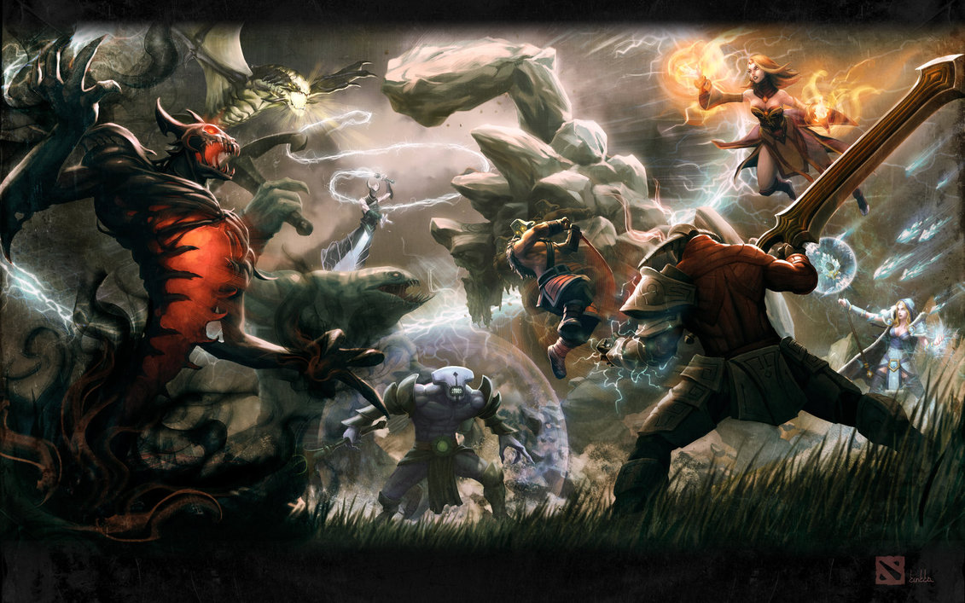
Credit to Dota Artist Kunkka

Slide 2
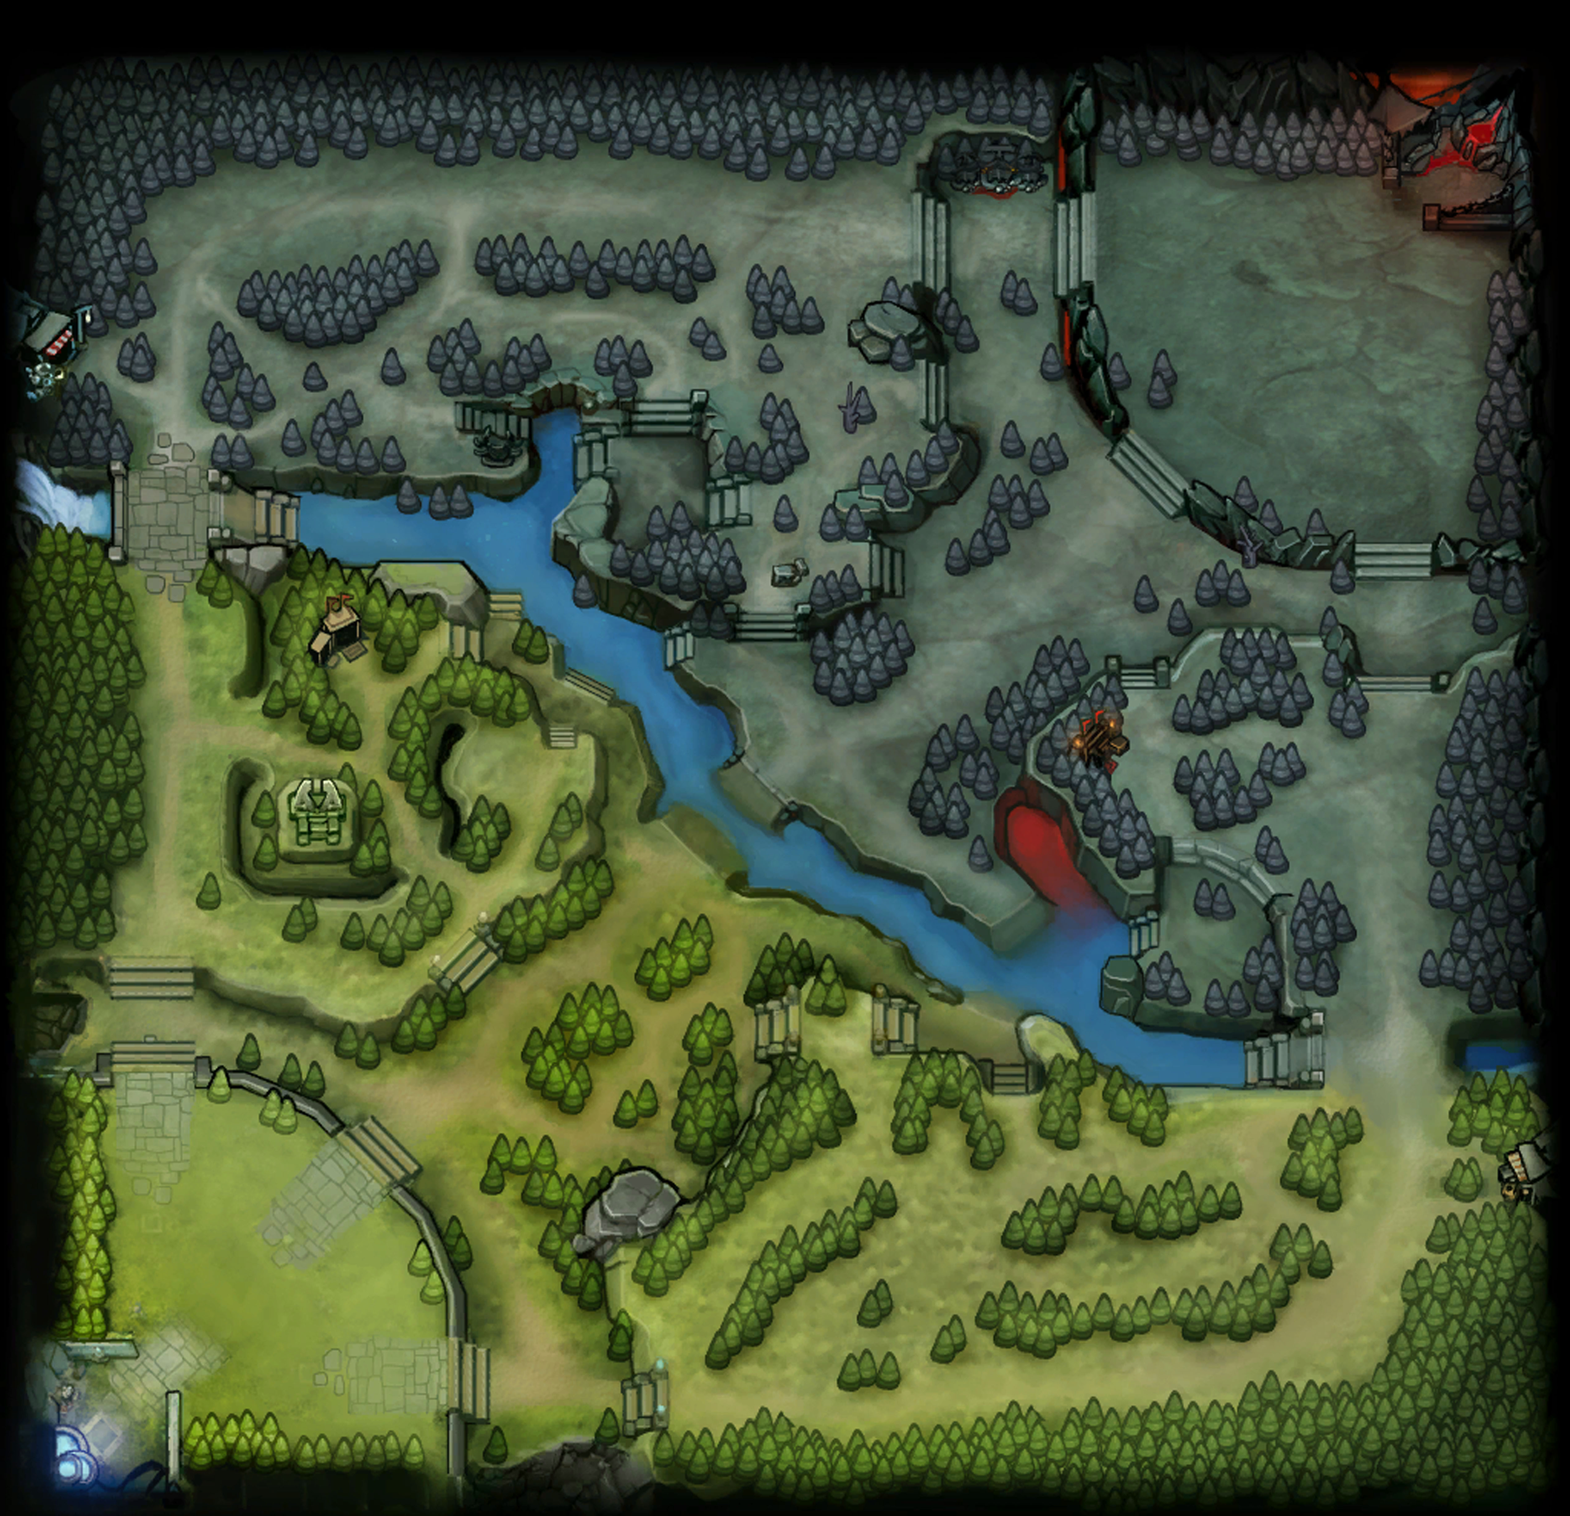
Angela Fan
Dire Ancient
Radiant Ancient

Slide 3
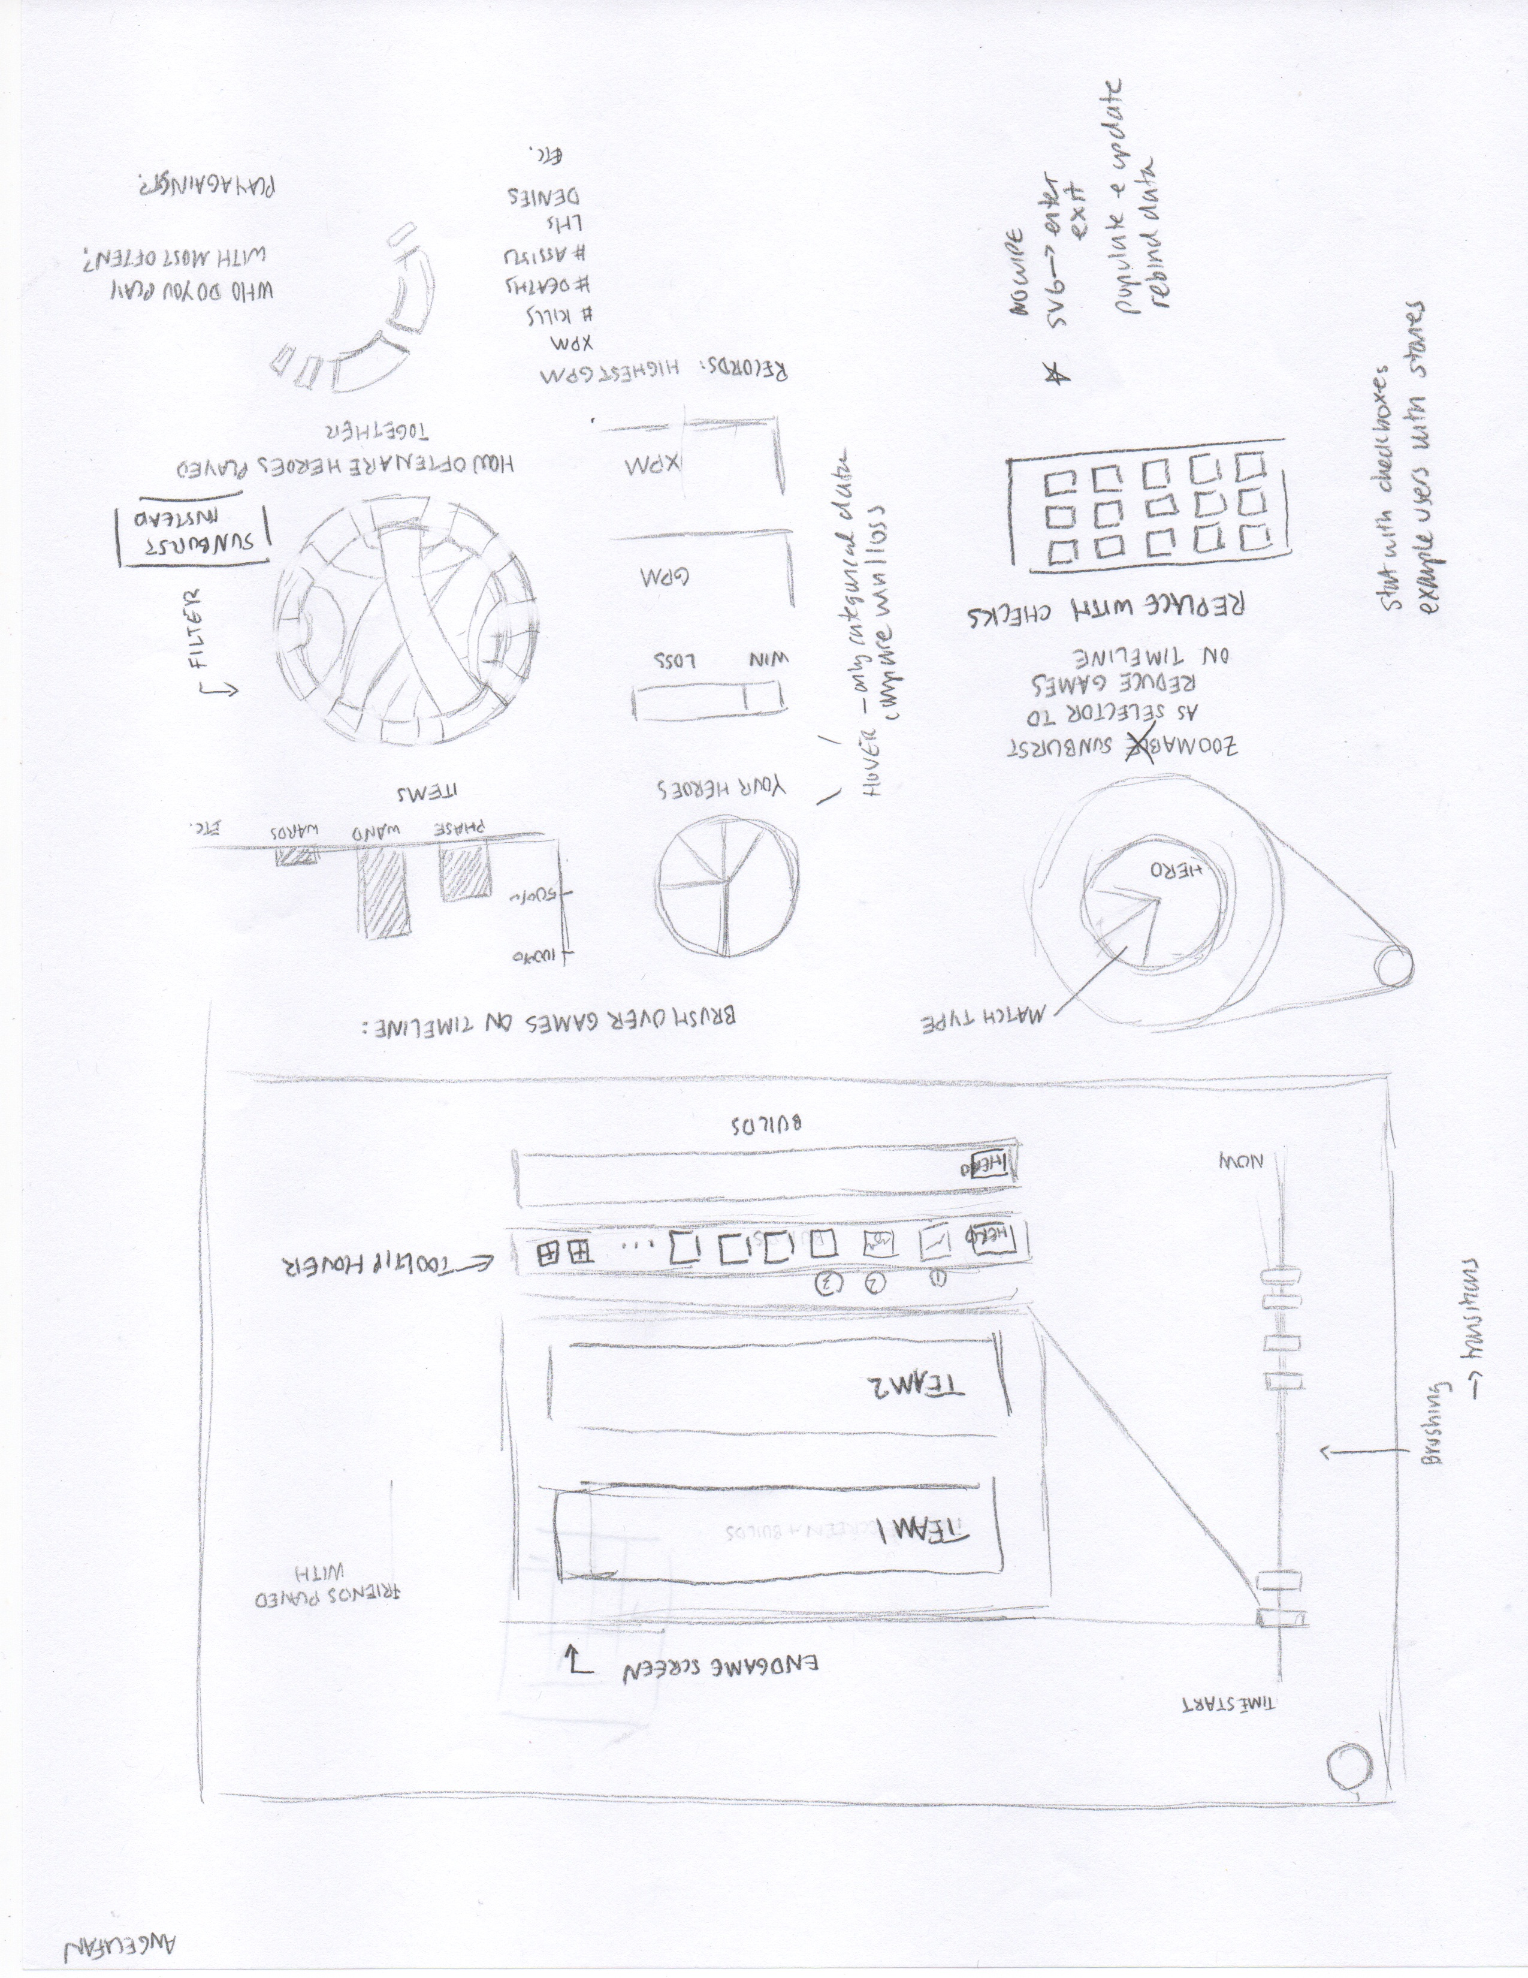
Overview Sketch, submitted with Project Proposal
Angela Fan
Main features:
Timeline down the left side of the page, displaying each user’s games. Has a brush feature so users can zoom in to a certain time period.
Has a selector in the upper left hand corner so users can filter down their selection by hero.
Main screen has a re-creation of the Dota2 endgame screen.
Contains a number of statistical data-driven graphs, such as a pie chart showing which heroes a user has played with, a chord diagram showing which heroes play together most often, and a bar chart displaying the items the user purchases most often.

Slide 4
Selector Design I
Angela Fan
Originally wanted a sunburst- people could filter by clicking on parts of the sunburst. This idea was not so good- if people wanted to filter across multiple categories, they would have to ascend and descend levels over and over again, and items would be difficult to find.
Simple dropdown with checkboxes- could be useful, but missing the pictures.
Images as selectors- this emulates the Dotabuff selector, as well as the setup of the Dota2 wiki. We chose to alphabetize within the Agility/Strength/Intelligence categories, as this would allow users to find heroes more rapidly (normal Dota2 order is the order in which heroes were added to the game, which is difficult to remember).
Most importantly, we don’t want the selector randomly hanging out all the time- we want the selector to only be brought up when necessary, so it should be a clickable button.
Users should be able to select all the heroes or subcategories of heroes without individually clicking each one, as that would be annoying.

Slide 5
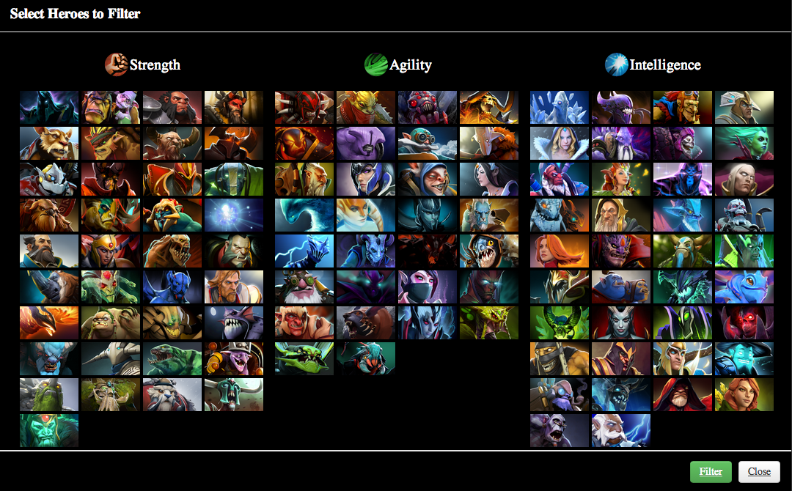
Selector Design II
Benjy Levin

Slide 6
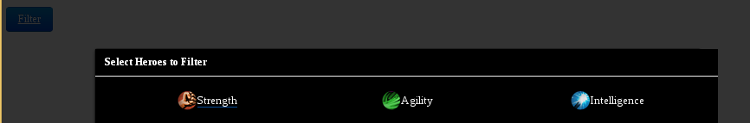
Selector Design II (continued)
Benjy Levin
Implementation Details:
Populates categories based on data stored in the heroes JSON. Utilizes floating images inside of a div, such that this solution is future proof if a new hero is added into the game.
Decided to use Bootstrap library to implement the filter button. Using the modal component, we can allow for the selector to be compactly located on screen in a button, and when the user clicks this button, the selector grid will open on top of the page’s data, and mute out the surrounding screen (as seen in the image above).
This is intuitive as the user must first make their filtering selection, and upon the closing of this modal, the page will now reflect the newly filtered dataset.

Slide 7
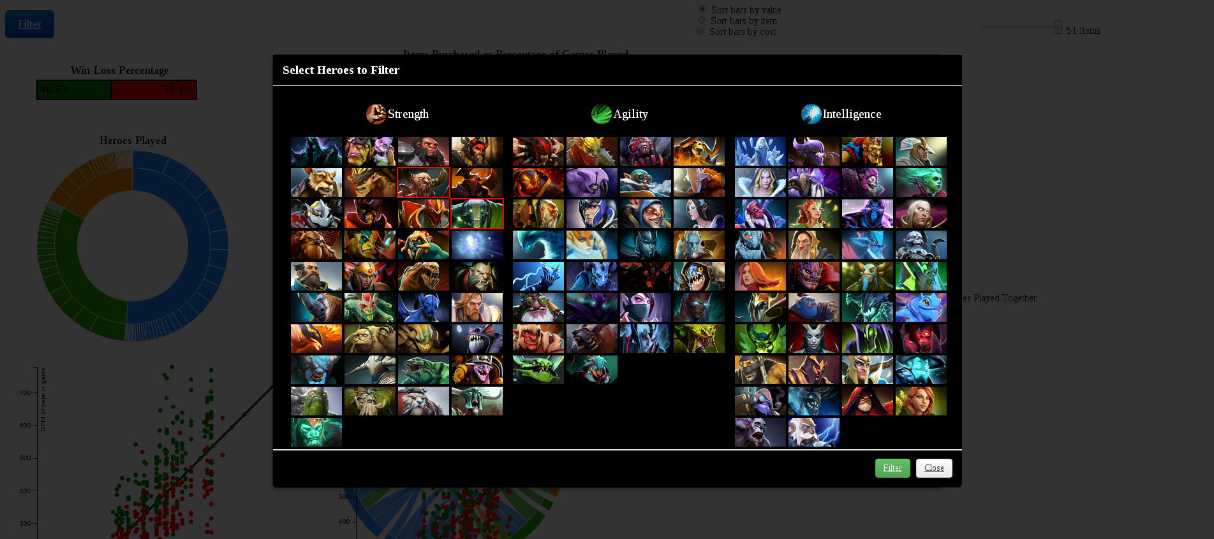
Selector Work III
Robbie Gibson

Slide 8
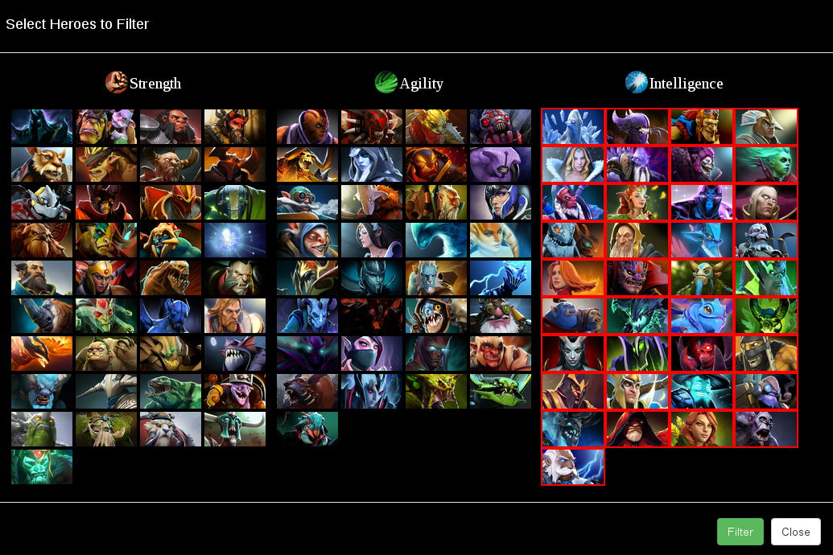
Selector Work IV
Benjy Levin
For ease of selecting each category, we made it such that if the user clicks on the heading: Intelligence, Agility or Strength, it will either select all the heroes in that category, or deselect all if they are all already selected.
We also solved the bug such that if the user makes a selection and then clicks CLOSE (and not filter), when the user reopened the modal, it displayed the unfiltered selection. Now, every time the modal is opened, the user is shown the heroes selected from the most recent filtering of the data set by heroes. This was a consistency error.

Slide 9
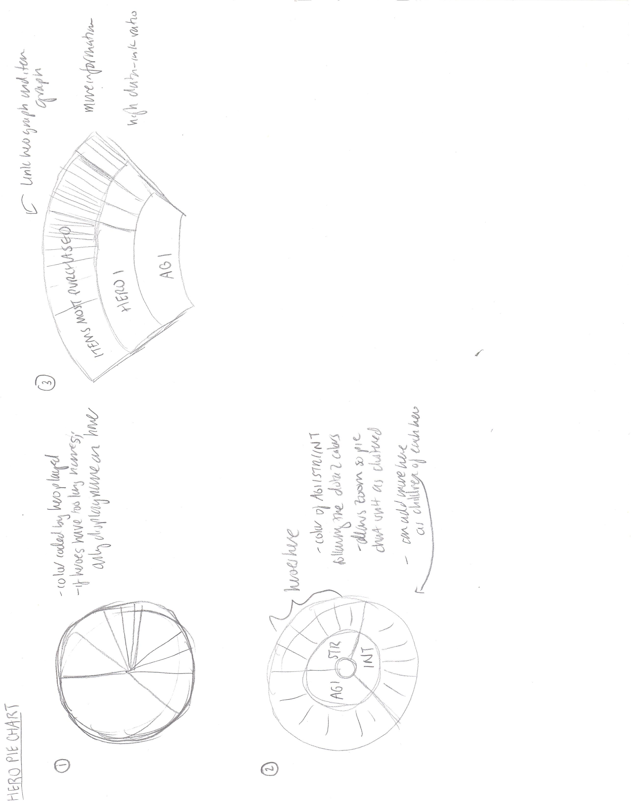
Designing the Statistical Graphs- the Hero Pie Chart I
Angela Fan
First Design- Simple Pie Chart
Pros:
Easy to understand
Cons:
A lot of tiny little slices that the user might not even be able to see, if we eliminate the pie won’t be 100% which is really bad
Overwhelming Graph with no interactivity
Second Design- D3 Sunburst Layout
Pros:
Zoomable so can keep a high data-ink ratio without overwhelming the user
Allows users to explore
We can add more information later by adding children to the sunburst layout, allowing more connection between graphs
Interactive + filterable

Slide 10
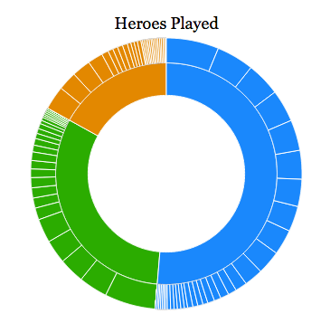
Designing the Statistical Graphs- the Hero Pie Chart II
April 5th Update
Angela Fan
Realization of the Sunburst Layout
To do:
1. Link this graph with items, possibly? More children.

Slide 11
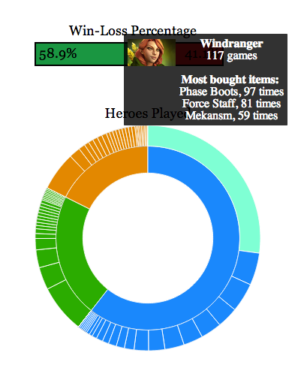
Designing the Statistical Graphs- the Hero Pie Chart III
Angela Fan
I added more information in the tooltip- now users can see, per hero, what items they purchased the most.
Originally I wanted to add each item as a child, but this proved to be too much, as often the item children nodes were impossible to see.
This information hopefully serves to better connect all of our graphs, and provide more specific information to the user.
If a user has purchased less than three items on a hero, none of them are shown. I decided this because it doesn’t seem to make sense to have a “most bought” statistic when you haven’t really bought anything.

Slide 12
Designing the Statistical Graphs- the Hero Chord Graph, Part I
Angela Fan
The design of this chord graph was particularly controversial in our group. We agreed that circles were aesthetically pleasing and an excellent way to achieve a high data to ink ratio, but also that circles are a little more difficult for the user to understand at first. There are a number of reasons for this:
There are many nodes and many chords
The relationship is bidirectional, but the color is only decided based on the color of the parent
Based on design studio feedback, we decided to consider making a matrix plot.

Slide 13
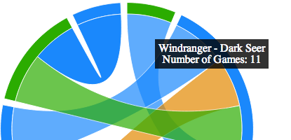
Designing the Statistical Graphs- the Hero Chord Graph, Part I
Angela Fan
In the end, I chose to stay with the chord diagram. I decided this because I think that visualization is partially about pushing the boundaries. People didn’t know they hated floppy discs until Steve Jobs took them away. Sometimes, users just need to learn to understand types of visualizations that are coming in the future.
However, in order to remedy some of the drawbacks of the chord diagram, I implemented a tooltip that allows users to tooltip over each chord. This lists which heroes the chords are going to, so users can just read off the hero names. Additionally, it lists the value that the chord represents, giving users a numerical understanding of the area the chord represents. I think this is better than a matrix color scale, since people inherently have better area perception than color scale perception.

Slide 14
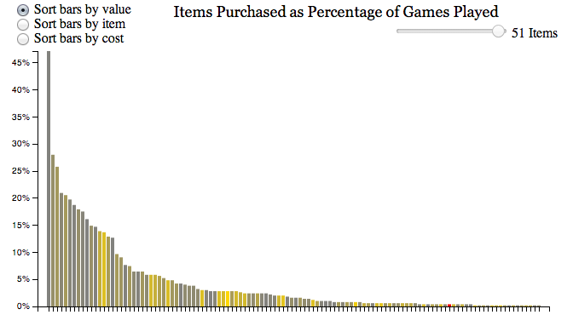
Designing the Statistical Graphs- the Items Bar Graph, Part I
Angela Fan
First Design- Bar Graph
Main worries:
The only other visual element of this graph is color, and here it is colored by cost. 1) not very intuitive and 2) not very useful- we already report the cost and allow sorting by cost. This coloring must be replaced.
2. NEEDS a color legend.
Features:
Slider bar filter so users can find top items
Sorting bars by value: this sorts by number of times the item was purchased- basically the main point of the graph
Sorting bars by item: this sorts alphabetically, so users can find the item they want- so if a user is more interested in one item, they can find that item
Sorting bars by cost: users may find this relevant, especially if they want to see how often they purchase a big expensive item
Tooltip for item, item picture, cost, and number of times purchased

Slide 15
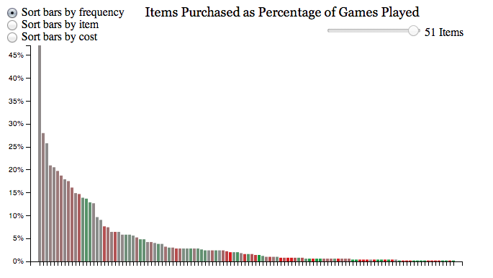
Designing the Statistical Graphs- the Items Bar Graph, Part II
Angela Fan
Added win/loss color scale, with gray color in the middle representing around a 50% winrate (i.e. neutral).
I decided this because the old coloring (by cost) didn’t make much sense and did not convey anything sorting by cost didn’t already convey to the user.
Second, coloring by winrate reveals some new information- some very expensive items don’t necessarily help one win, and some very commonly bought items don’t contribute to winrate at all.
I decided to add a gray in the middle in order to prevent the red and green colors from mixing into brown at 50%, which makes the page look very dreary and is hard to distinguish from the red. This gray in the middle makes it more clear at first sight what is actually red and green, which is the point of the coloring.

Slide 16
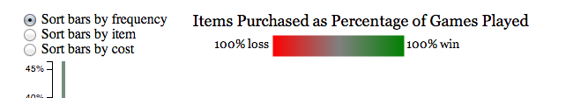
Designing the Statistical Graphs- the Items Bar Graph, Part III
Angela Fan
Added legend- I decided to do this so it would be clearer to the user what s/he was looking at, since it is not a straight win/loss scale. This gradient scale makes it clear that the color gray floats between a win and a loss.

Slide 17
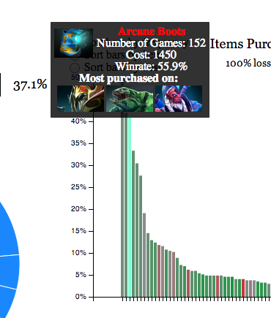
Designing the Statistical Graphs- the Items Bar Graph, Part IV
Angela Fan
I added in the tooltip, the images of the heroes you have most purchased a given item on.
This was to fit in with our theme of connected graphs.
Additionally, this information cannot really be found elsewhere, but is useful and interesting for the user to know.
I chose to add this information in the tooltip, because the graph already shows a lot of items. I didn’t want to bring up a table of users or anything like that, because the page is quite crowded and I am not sure where to put it so it fits nicely, given all of the sorting mechanisms that move the bar height around.

Slide 18
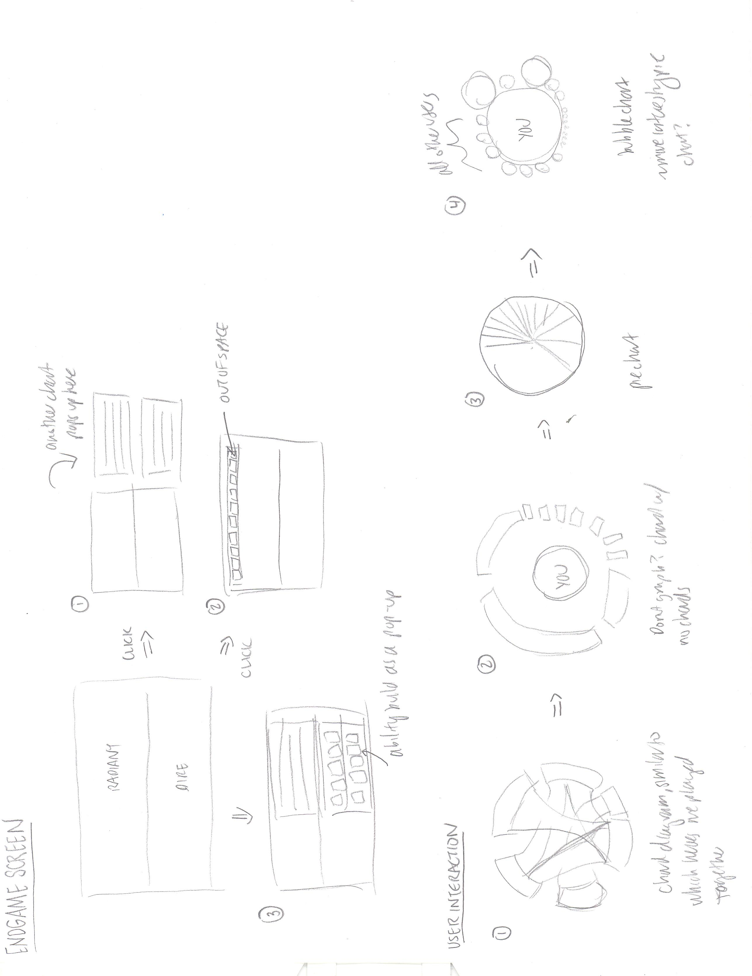
Designing the Statistical Graphs- the User Interaction Graph, Part I
Angela Fan
Chord Diagram
Pros:
Looks pretty cool, makes sense intuitively
Cons:
1. We don’t have the data for that many users, so we can’t represent interactions between other users. There aren’t that many chords!
No chords Chord Diagram
Pros:
Makes sense. Chord diagram without chords.
Cons:
1. Chord diagram without chords == bar chart?
Pie Chart
Pros:
Most sense! Intuitive!
Cons:
1. Users who I’ve only played one game with aren’t very interesting, but if we filter, the pie chart no longer represents 100% anymore

Slide 19
Designing the Statistical Graphs- the User Interaction Graph, Part II
Angela Fan
Bubble Chart
Pros:
More interesting visually than pie chart
Can filter it so it doesn’t necessarily need to represent 100%, but can display only users that you’ve played more than one or two games with
Cons:
Not as intuitively understandable as a pie chart
The central bubble that represents “you” is very very large compared to the other bubbles

Slide 20
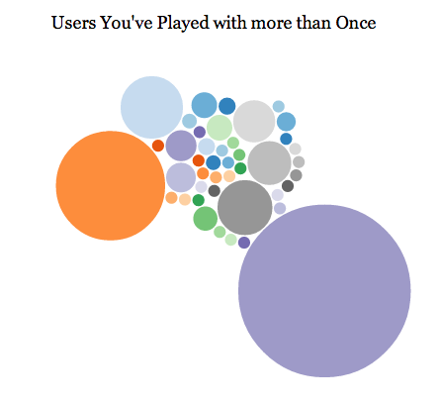
Designing the Statistical Graphs- the User Interaction Graph, Part III
Angela Fan
Circles are sized by number of games played together, and circles with a size of 1 are removed (because it doesn’t make sense to see everyone you’ve ever played with). Here, three interesting groups are highlighted:
Robbie’s “main” Dota-playing group- his brother (orange) and Benjy (light blue)
Robbie’s secondary Dota-playing group- the slightly smaller circles, of other Harvard players and/or his brother’s friends
People of Robbie’s skill level that he has played in the past, either as part of the Collegiate tournament, or completely random people in the Dota world that he’s played with often
Mousing over gives number of games played together and user id.

Slide 21
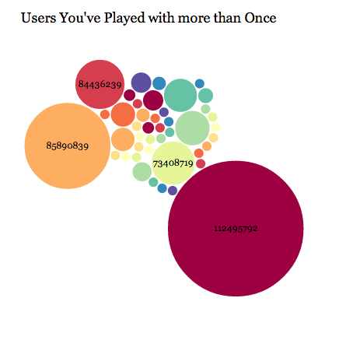
Designing the Statistical Graphs- the User Interaction Graph, Part IV
Angela Fan
Changed coloring to a rainbow Colorbrewer scale for more color to the page, and also labeled the circles by user id if the user-id fit on the circle.
The coloring is much friendlier, though honestly color for this graph doesn’t really mean much- things that are colored the same are not necessarily related, which is problematic. However, a colorful graph is far more interesting than one in steelblue, so we ultimately decided to color the nodes.
Left to change:
Click on circle to be taken to user’s Dota profile
Change user id to username

Slide 22
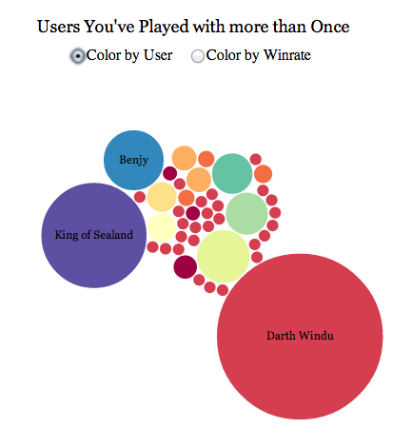
Designing the Statistical Graphs- the User Interaction Graph, Part V
Angela Fan
Instead of seeing a 32-bit user id, now users can see the names Dota players use in-game. These were called from the API by Robbie.
I decided again that the smaller circles wouldn’t have names if the user name was too long. This is purely for visual purposes.
Additionally, there is now an added tooltip- you can tooltip over the circle to see user name and how many games you’ve played with them.
Lastly, clicking on the circle takes you to the user’s profile page on Steam, a distribution software from which you play Dota2.

Slide 23
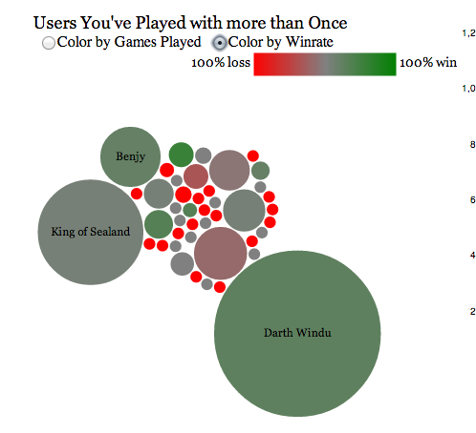
Designing the Statistical Graphs- the User Interaction Graph, Part VI
Angela Fan
Also added a color by winrate option, so users can see who they win with the most, and who they lose with the most. Perhaps this could adjust which groups of people they play with.
This is accessible as a toggle- choosing “Color by Winrate” also brings up the legend bar, and choosing “Color by Games Played” hides the legend bar.
I chose to toggle because I think the coloring by winrate is less aesthetically pleasing than using the colorbrewer scale. Additionally, I think Coloring by Number of Games played together helps users of this graph visually cluster circles of the same size with the same color, so they don’t have to rely solely on their area perception.

Slide 24
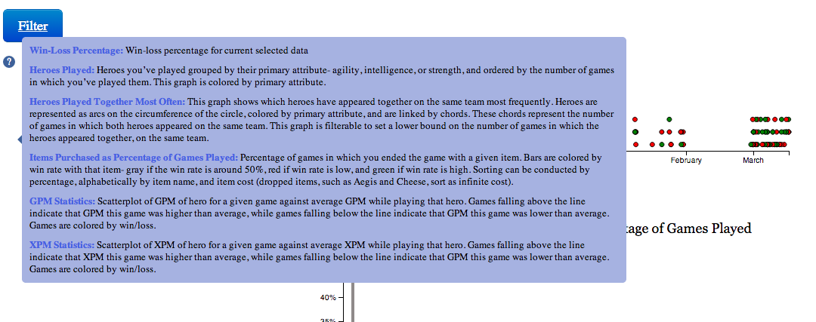
Help Menu for the User
Angela Fan
Definitely a typical question for any user is “what on earth am I looking at?” so we decided to insert a little help description- includes what the coloring scale is, what a mouseover does, what filtering methods there are, and what the graph displays. Users bring this up by mouse-ing over the little questionmark symbol at the top of the page.
We wanted to make this non-obtrusive and not a mandatory popup, as this would be more user-friendly for people who knew how to use this tool already and were not first time visitors. Additionally, we didn’t want to clutter the page with descriptions next to every graph, as this would reduce the data-ink ratio and reduce the whitespace on our page, making it less aesthetically beautiful and less data-intensive.

Slide 25
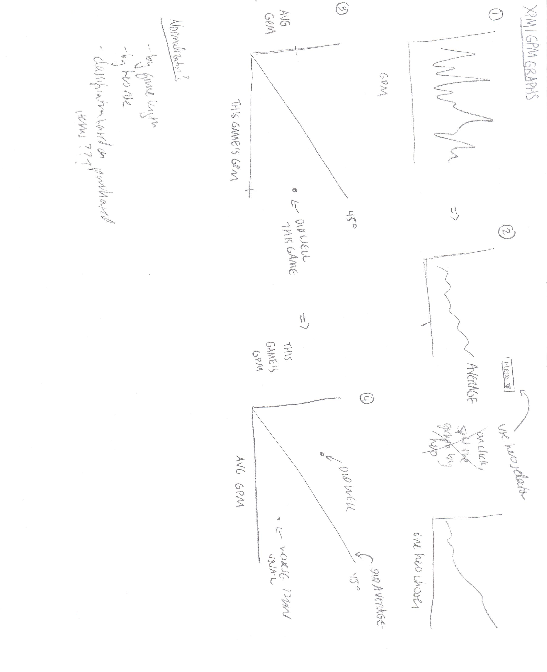
Designing the Statistical Graphs- the GPM/XPM Graphs I
Angela Fan
Line Graph
Time on X-axis, GPM on Y-axis
Pros:
Basic
Cons:
Not good measure- no normalization
No good comparative ability
Terrible way to detect trends
Line Graph II
Time on X-axis, GPM on Y-axis, but only the user’s average is plotted. There is a dropdown menu at the top of the graph, so user can pick to change which hero is plotted
Pros:
Can now try and detect hero-based trends
Cons:
Not good measure- still no normalization
No good comparative ability between heroes
Introduces yet another selector that overcomplicates the whole graph system

Slide 26
Designing the Statistical Graphs- the GPM/XPM Graphs II
Angela Fan
Scatterplot I
Average GPM for that hero on the x-axis, GPM for that game on that hero on the x-axis
Pros:
Comparative! Not between heroes but at least between games
Cons:
Not intuitive, since below the line is a “good game”
Still no normalization, and not comparative between heroes
Scatterplot II
Average GPM for that hero on the y-axis, GPM for that game on that hero on the x-axis
Pros:
Comparative! Not between heroes but at least between games
Intuitive, since being above the line is great game and being below the line is a bad game
Cons:
Still no normalization, and not comparative between heroes

Slide 27
Designing the Statistical Graphs- the GPM/XPM Graphs III, April 5 Update
Angela Fan
Normalization Needs
Over game length- in a longer game, heroes on average get much stronger than in a shorter game
Data bias- sometimes the game ends accidentally before it actually begins- these GPM/XPM values are skewing the mean
Based on hero role- if you play different roles, sometimes you have different GPM/XPM. If a hero can fit multiple roles (carry/support, like Alchemist), then the mean isn’t a good representation of an average game of either role. For example, if you play carry Alch 50% of the time and support Alch 50% of the time, the mean GPM floats between the two, but that doesn’t mean that your support Alch games are “worse” games on average
This graph doesn’t help evaluate how heroes do with farm, or how fast a hero can farm, which are both interesting questions.
Future Development
A good question this graph could answer is “what happened in that game???” if the game is “worse” than average. We need to have an on click event, that brings up the end-game screen of the respective game.

Slide 28
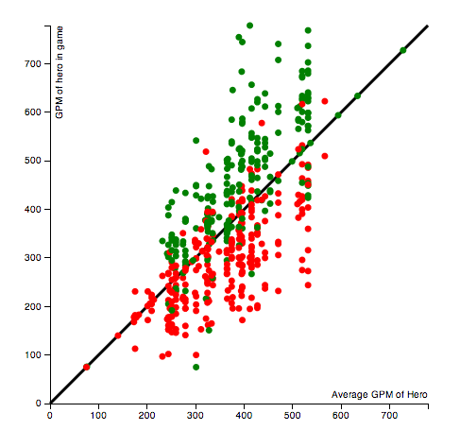
Designing the Statistical Graphs- the GPM/XPM Graphs IV, April 5 Update
Angela Fan
Looks pretty good.
Heroes are lined up in lines based on the x-axis, which are heroes that are played often.
Has a tooltip mouseover.
Need to have on-click event.

Slide 29
Designing the Endgame Screen I
Robbie Gibson
Sketches by Angela

Slide 30
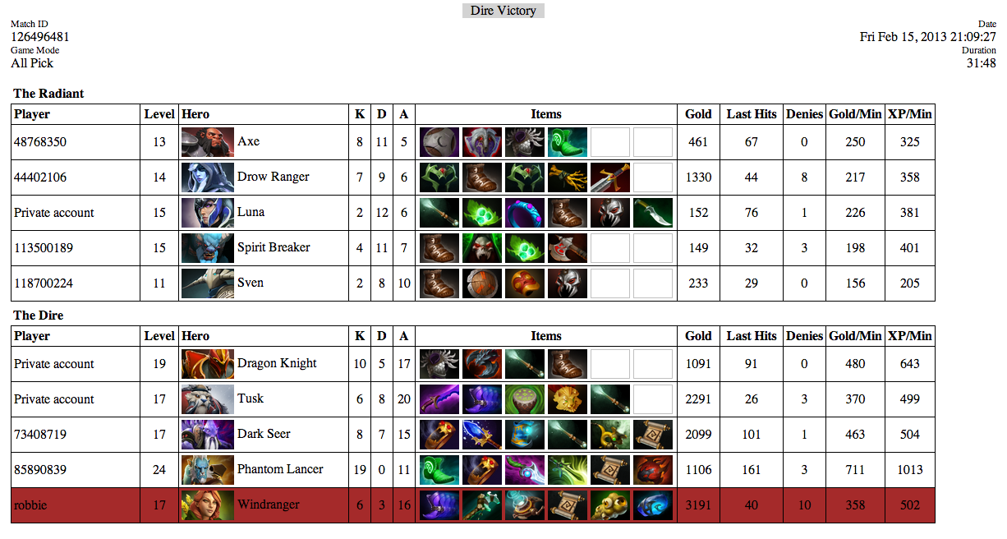
Designing the Endgame Screen I
Robbie Gibson

Slide 31
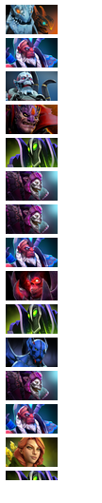
Designing the Timeline
Benjy Levin
Design Process and Evolution:
We originally planned to have a timeline down the left side of the page, displaying each user’s games. Has a brush feature so users can zoom in to a certain time period.
Decided to implement this using the image of the hero that the player played in a given game. However, upon implementing this solution, we realized that a given user could typically have 500+ games and thus 500+ icons, which were far to many to scroll through in a div with scrollbars.
In addition to this issue, we realized that time is more intuitively perceived linearly from left to right, not up to down or down to up, and when a brushable timeline is implemented, it is far better design practice to have the entire time period in view, rather than having to scroll.
Decided to pursue a different implementation.

Slide 32
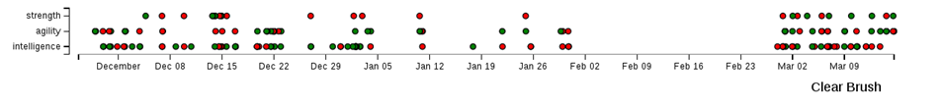
Designing the Timeline
Benjy Levin
Overview of all games played over time, divided into three rows based on the main attribute (strength, agility, intelligence) of the hero you played in that game. Colour encoded as red for win or green for loss for that game.
Timeline is brushable (see highlighted section above), and upon brush, the graph will zoom into that area and redraw the x axis with more detail based on this new selection – see
Upon zooming in, a “Clear Brush” button will appear in the bottom right, that will logically clear the zoomed in brush when clicked.

Slide 33
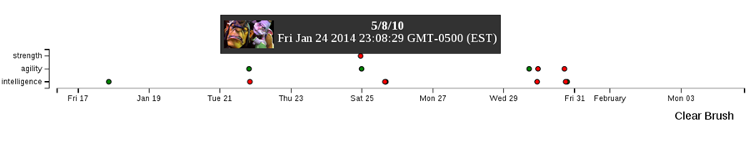
Designing the Timeline (continued)
Benjy Levin
Upon mouseover, a tooltip is displayed with some further details about that game, such as the image of the hero you played, your number of kills/deaths/assists in the game, and an exact game time.
Future Development
On click of each node, display the summary statistics for that particular game throughout our visualization.

Slide 34
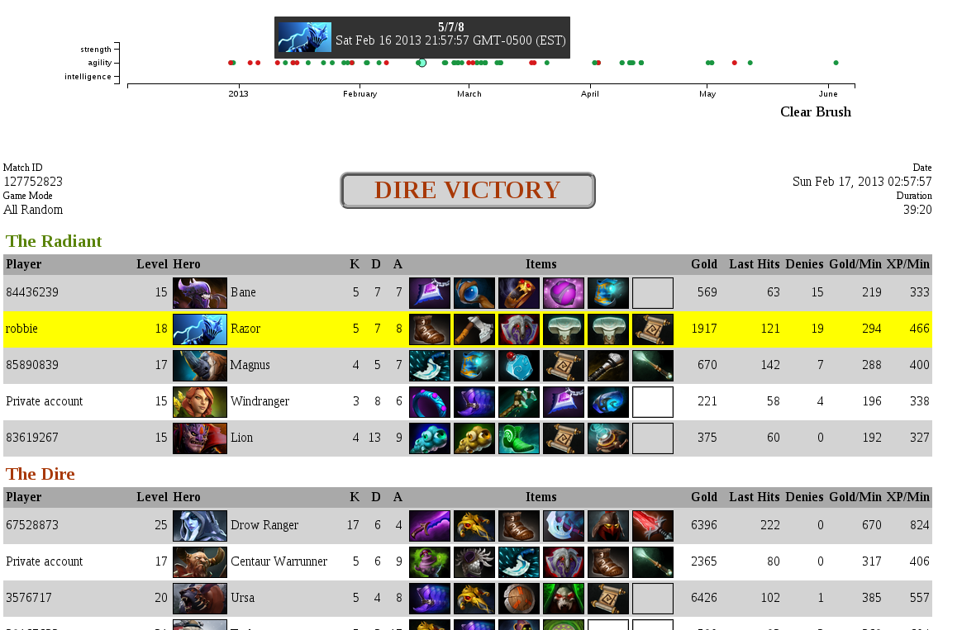
We decided that it would be nice to highlight the match dots when you hover over them. This also highlights the match dot in the GPM/XPM graphs, and stays when you click on one to show the match screen.

Slide 35
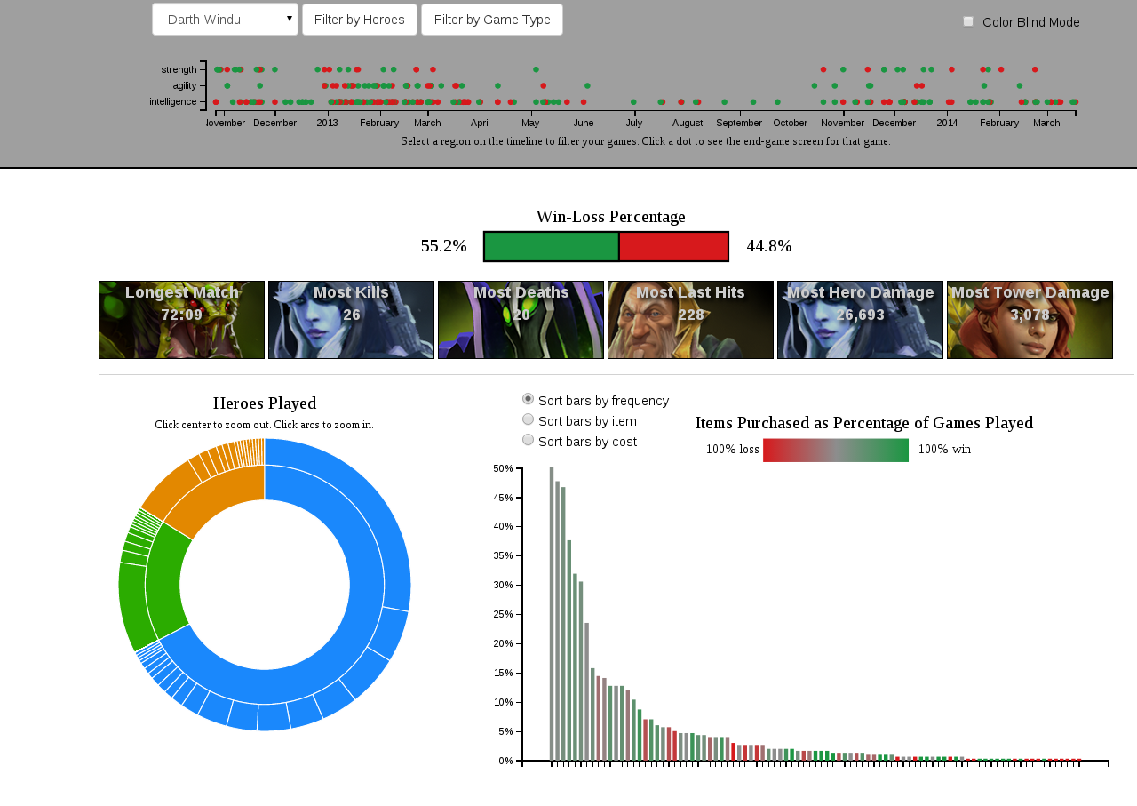
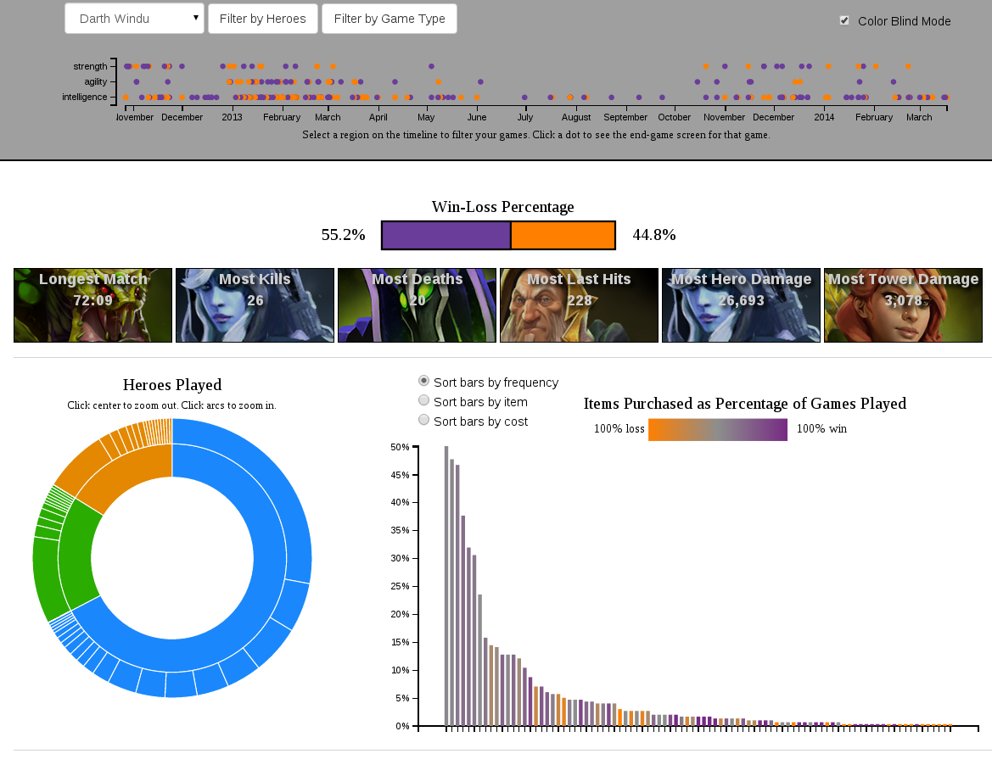
Dynamically Changing CSS – colorblind.css
We felt that since we are using 2 very color-blind unfriendly colors (red and green) which traditionally represent “win” and “loss” in Dota 2 and universally, it would be appropriate to give the user the option of dynamically changing these colors to something more color-blind friendly if required.
By dynamically adding (or removing) colorblind.css to the DOM, which then over-shadows our main.css file, and then redrawing the graphs, we were able to achieve the desired toggle on/toggle off effect.
BEFORE
AFTER

Slide 36
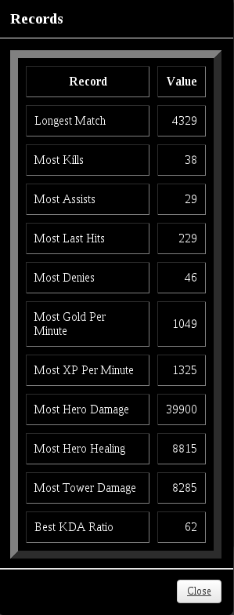
Designing the Records
Benjy Levin
Motivation
Players love to view their historically best scores in various categories. This not only serves as a nostalgic/boastful moment to reminisce on great games past, but could assist in analyzing why said game was so exceptional and what could one learn from it.
Design Process and Evolution:
The records started off in the basic form as a table inside a modal that displayed various record-worthy categories and the value associated with those categories.
This was accomplished by building a record JSON that is updated by traversing through the matches array of the current filtered data selection, and then updating each field accordingly.
We felt that although the table provides the information desired, it is not aesthetically pleasing. So we opted to go for something a bit more visually stimulating and informative.

Slide 37
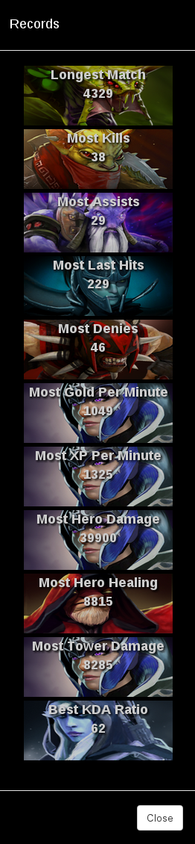
Designing the Records (continued)
Benjy Levin
We transformed this boring tabular layout into a single columned table that the background image displayed was the hero you played in the game in which the record was achieved.
This is also more informative and makes use of something aesthetically pleasing to convey more meaning.
We also added an on click event for each of the pictures that will bring up the end game screen for that particular match in which you achieved said record. This way, the user not only can identify his best life time records, but find more information about those games.
The record that you are hovering over is emphasized, and the cursor changes to show that it is selectable.
We felt that having the records in a modal was a bit annoying and that records are something that users are very interested in based on filtered selection. So we decided to move the records out of the modal, display them on the front page where they are easily visible and clickable, and to only display the 6 most useful records.
Final Record Layout

Slide 38
Designing the Game Type Filters - Info
Benjy Levin
Motivation
Although the basic game mechanics of Dota are the same from match-to-match, there are a few customizable options when a user searches for a game to play. The two categories that these can be broken down into are: Game Mode and Lobby Type.
Game Mode determines the way in which Heroes are selected. These include All Pick (each player can choose their hero from the full pool of all available heroes), All Random (each player is randomly assigned a hero from the full hero pool), and Single Draft (each player picks their hero from 3 randomly chosen heroes from the full pool of heroes) – to name just 3 modes.
Lobby Type determines who the game is played with – i.e. the people who will then be choosing a hero based on the game mode above. This includes Public Matchmaking (whereby your group of friends search for other teammates online – to make a team of 5 – and 5 random opponents), Ranked (where you play with people of a similar skill level to you – kind of like a chess ELO rating), or Solo Queue (where you search for random teammates and opponents all by your lonesome).
It would be useful to filter by these Game Types to see user specific stats based on different game modes and lobbies.

Slide 39
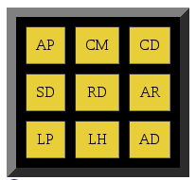
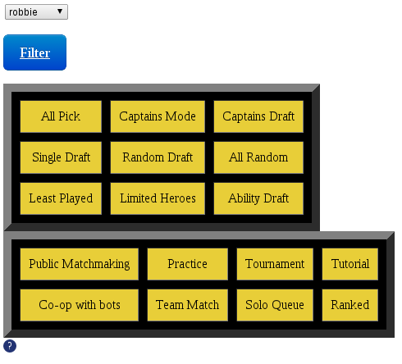
Designing the Game Type Filters
Benjy Levin
Design Process and Evolution:
We originally just placed a square table to filter by Game Mode (AP = All Pick, etc.) on the main graph page. On click, it would update the filtered data based on the user’s toggled selection.
Although this was functional, it was not ideal as it lacked the functionality of filtering by Lobby Type, and was not user friendly for those who do not understand the abbreviation.
We expanded the names in full, and added the functionality to filter by lobby types.
However, having this on the main page was very cluttered and aesthetically unpleasing, so we moved it into a modal (like the hero filters) and styled it further.

Slide 40
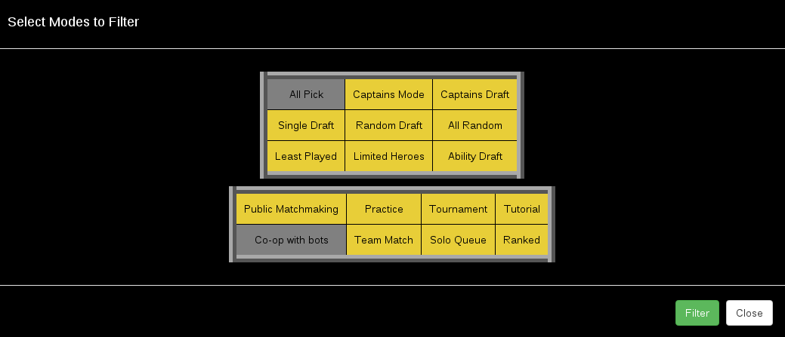
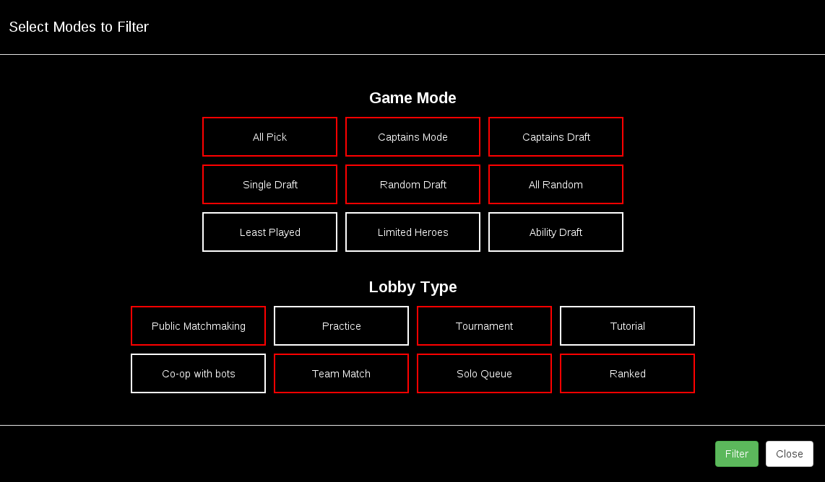
Designing the Game Type Filters (continued)
Benjy Levin
5. This was aesthetically much more pleasing. We also changed it such that the filtering only occurred on click of the filter button, which prevented some of the graphs displaying incorrect info if the user clicked on different modes in quick succession. The webpage saves the state of the selection, so even if the user makes a selection and then CLOSES the modal without filtering, upon reopening, the most recently applied filter selection is still displayed.
6. However, we felt that the filter layout, and styling did not fit in well with the rest of our webpage, so we restyled the table layout to be more in line with the webpage’s layout and the hero filter modal. We also added titles to the 2 different filtering categories. We also decided to default to a few modes unselected, since they are not of immediate interest, and may skew the “typical” user information shown on load (i.e. Practice matches or Tutorial games).

Slide 41
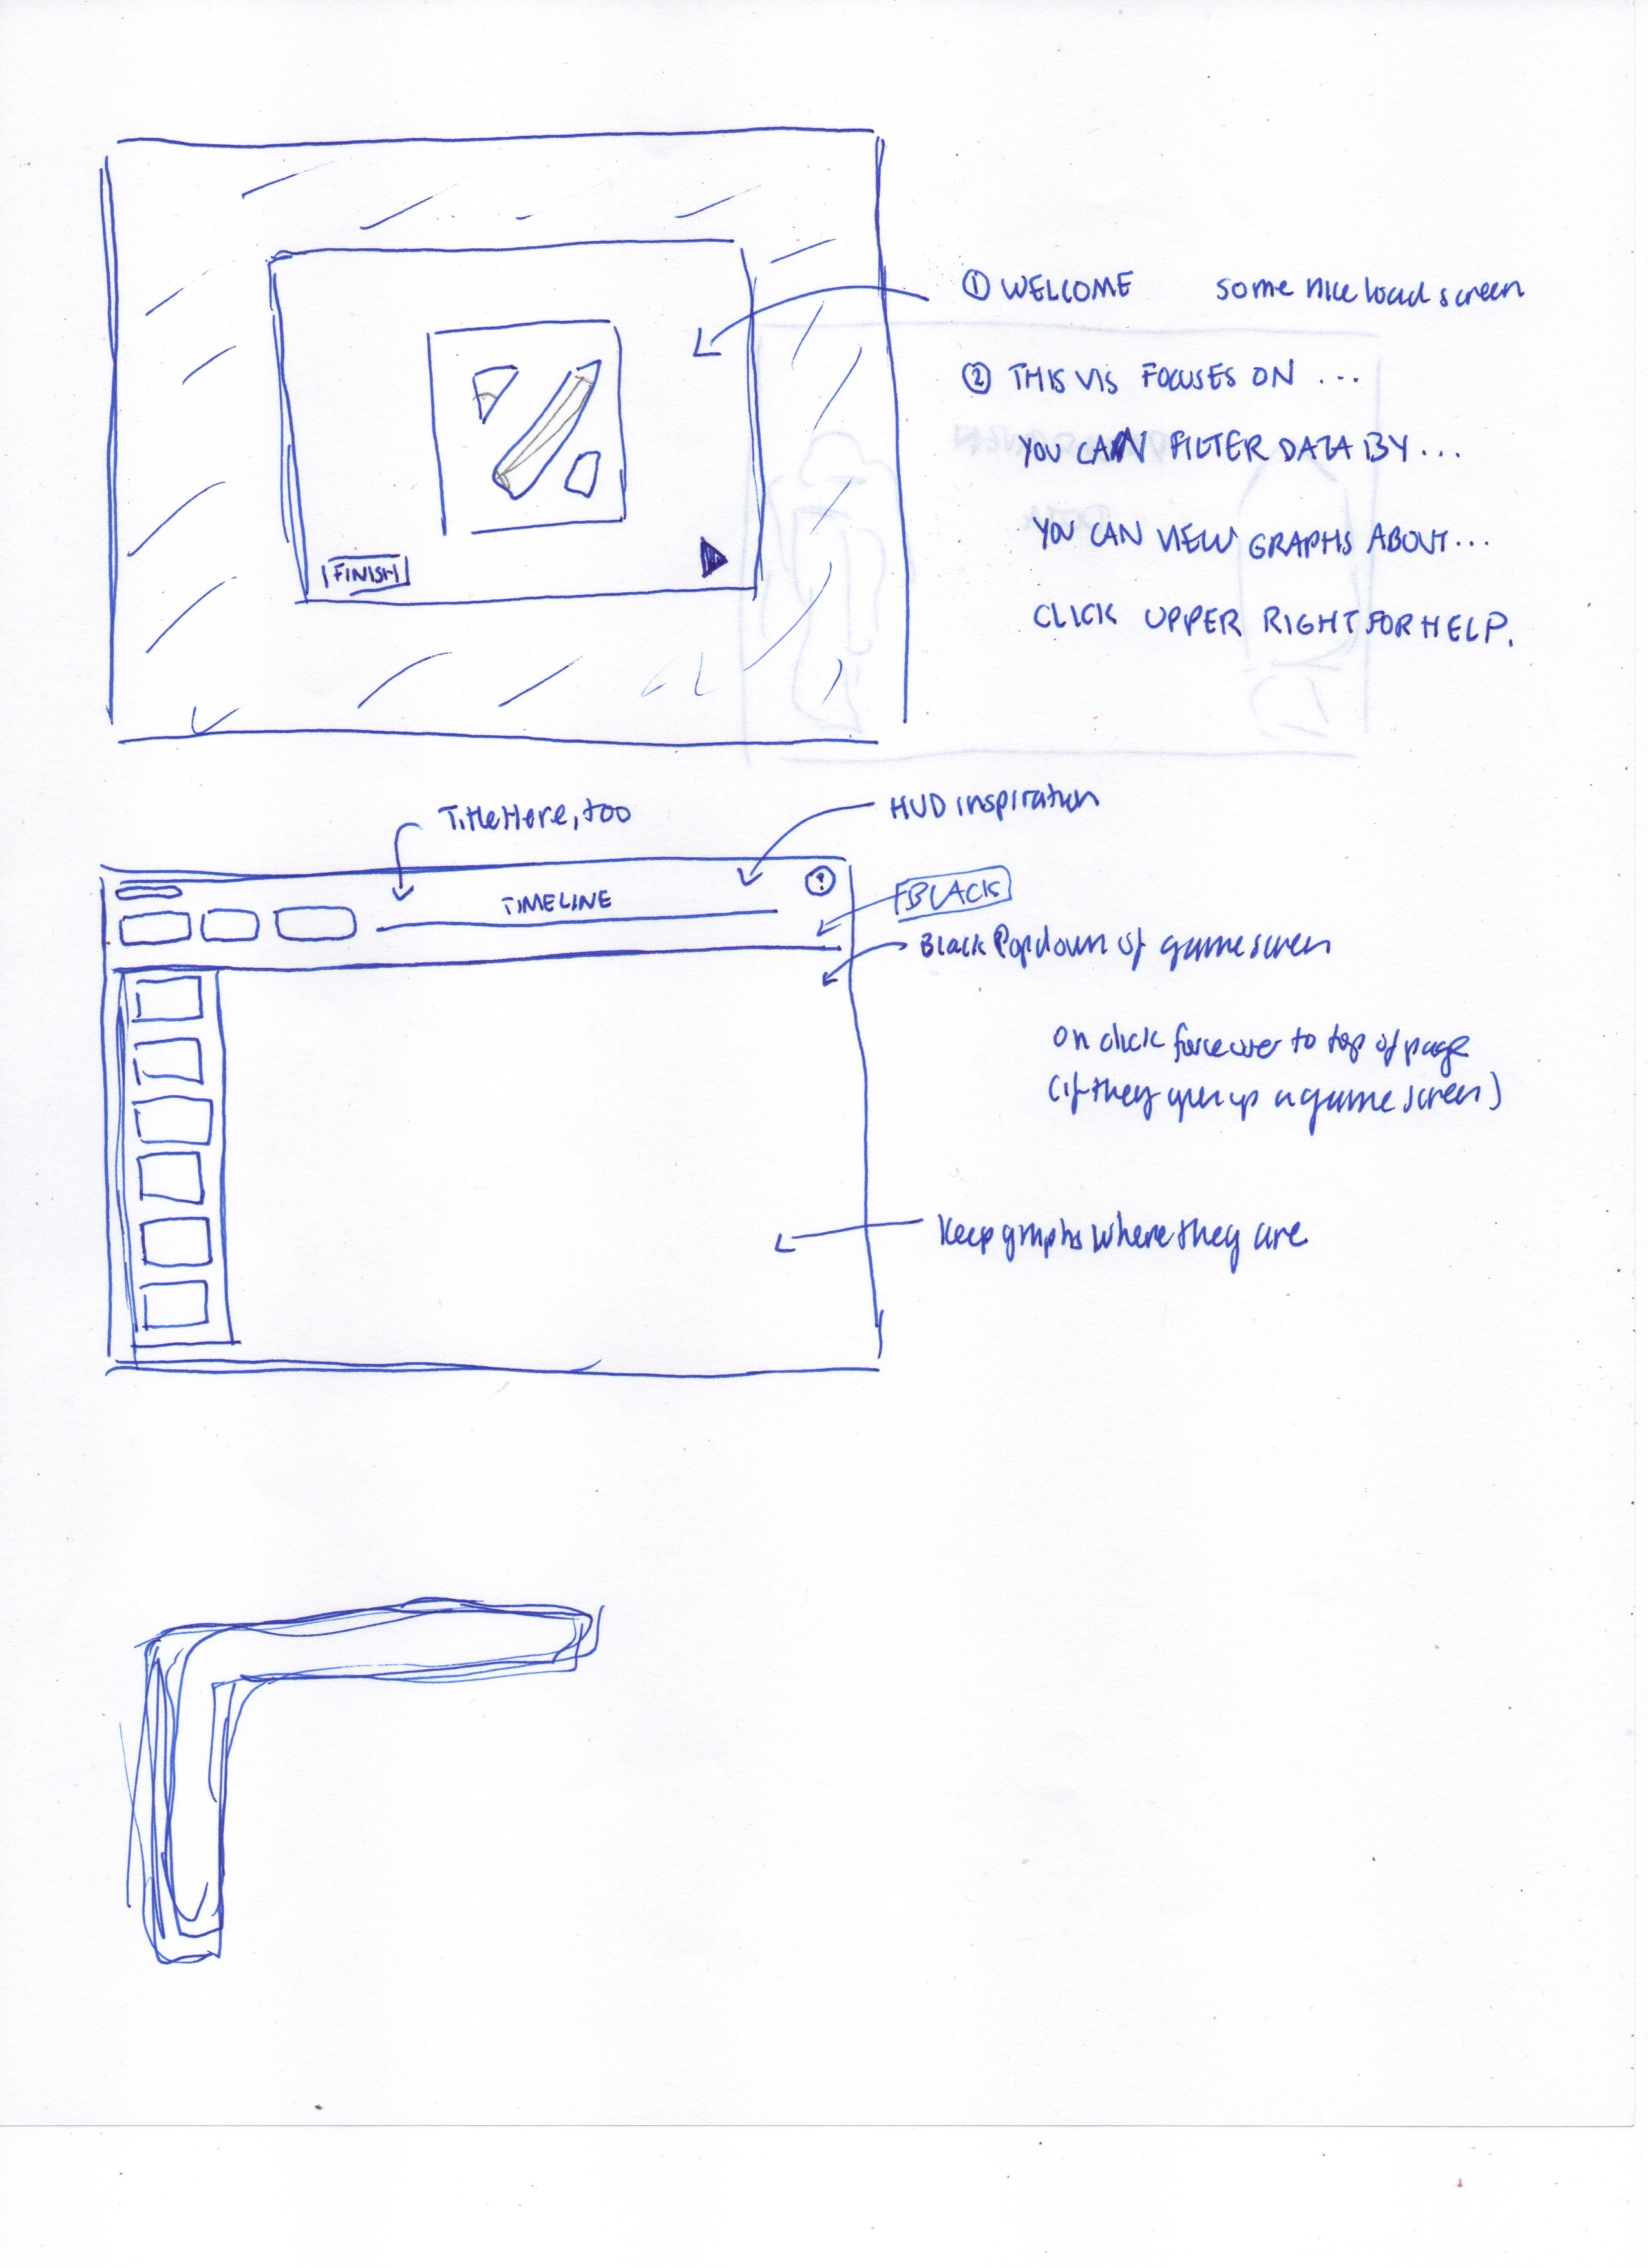
Angela Fan
Layout
Now that we had the basic graphs done with filtering, we had a team meeting to decide the final layout. We each designed a layout with accompanying sketches, and in the end decided on our current layout for a few reasons:
We wanted the user to be able to balance scrolling and clicking. Because our project already had so much clicking and hover events, we wanted the user to still be able to scroll down smoothly.
We wanted the filtering header to clearly stand apart as something different, so we had it maintain absolute position in the scroll.

Slide 42
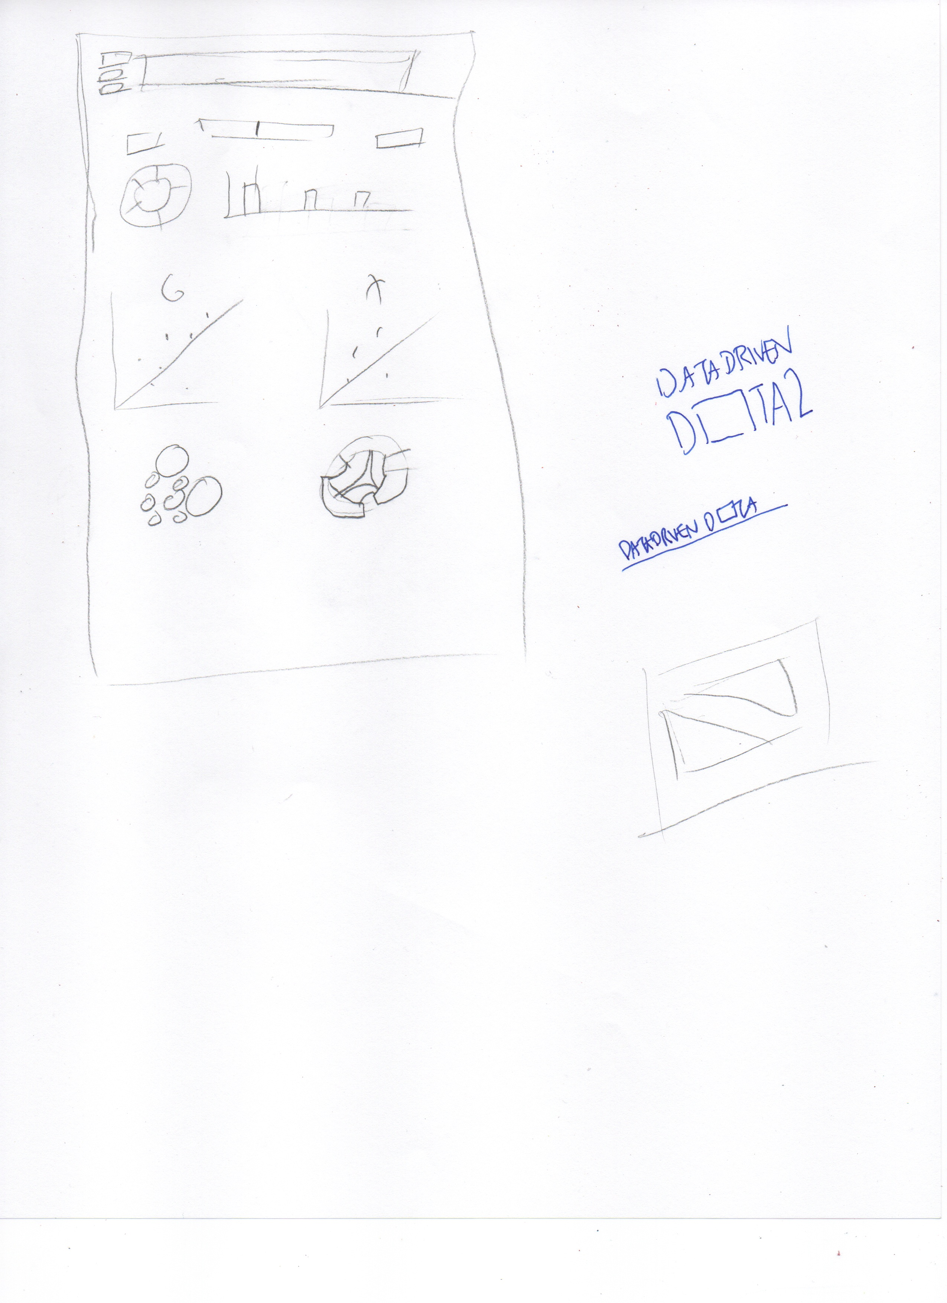
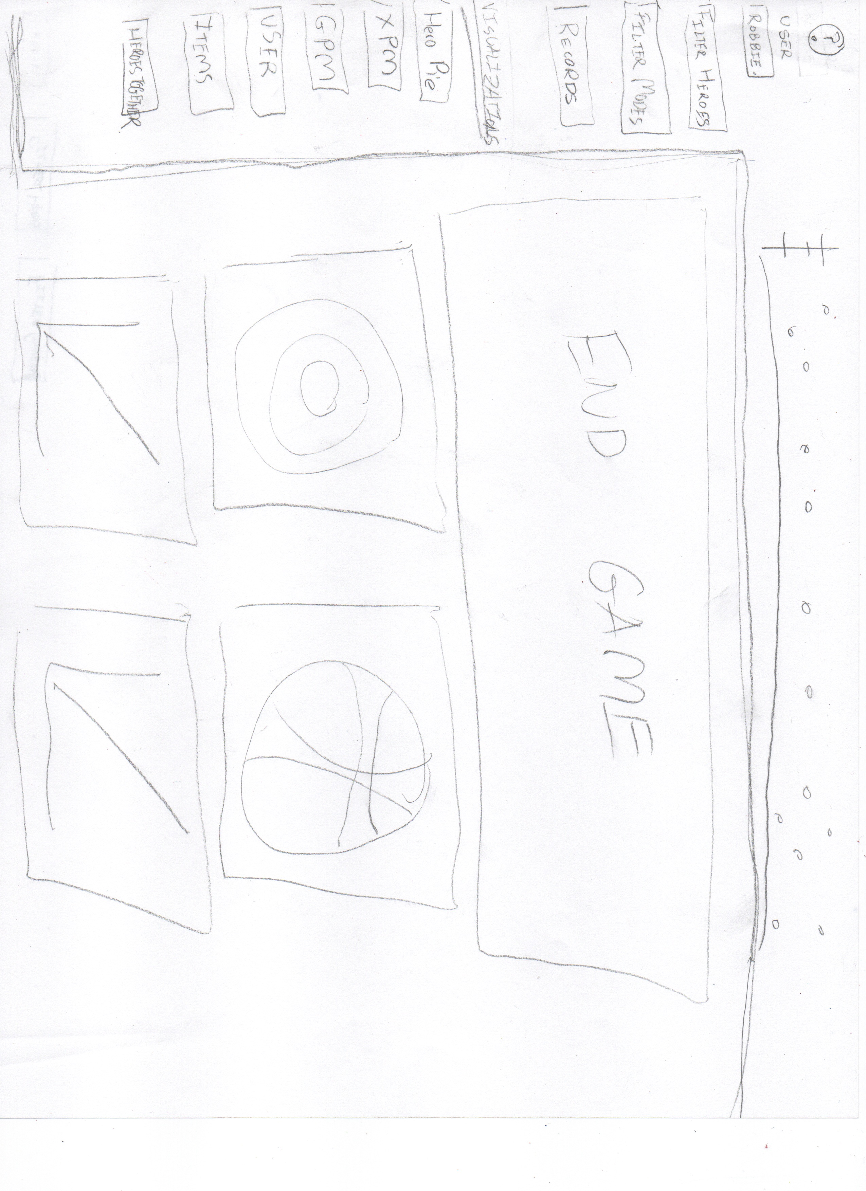

Slide 43
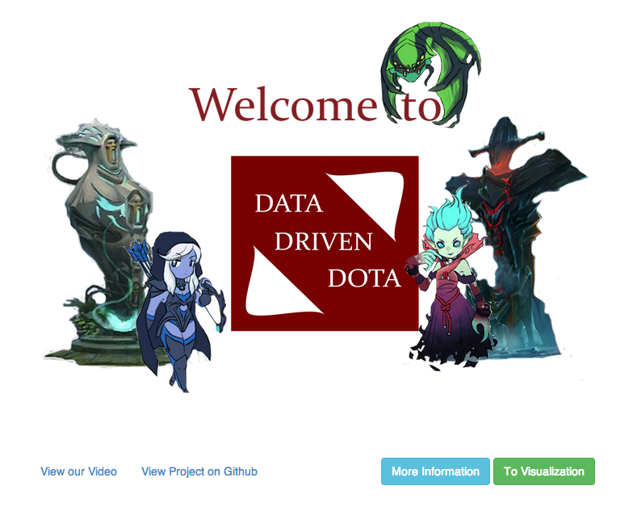
Introductory Splash Screen
Logo
White normal distributions represent statistics.
The towers represent Radiant and Dire. Three heroes are represented here.
Links to see video and project page
Brings up basic introduction to the project
Takes user to visualization

Slide 44
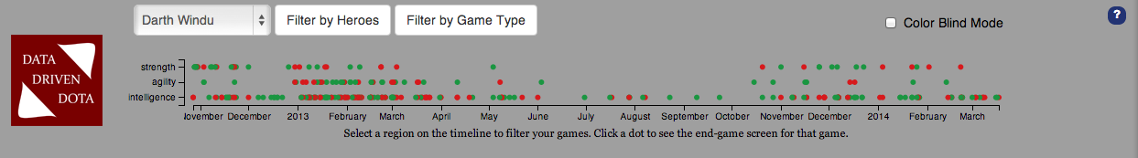
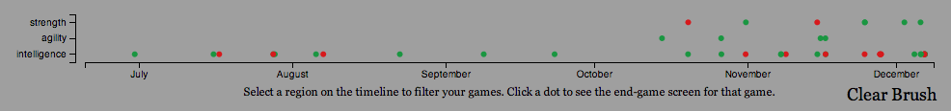
Header
Select user dataset
Filter by hero or game type
Toggle Colorblind mode
Graph descriptions
Timeline. Brush to reduce data selection by time period.
When brushed, looks like this
Press to clear the brush

Slide 45
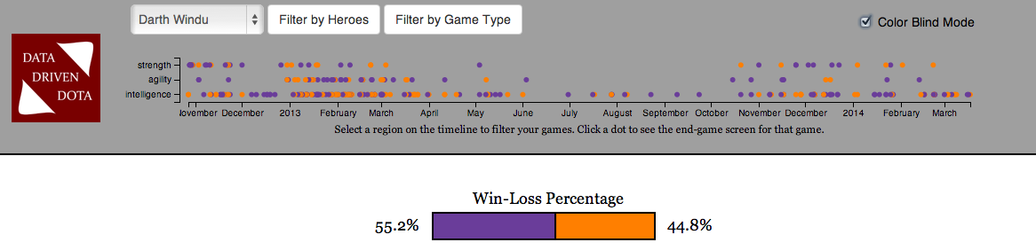
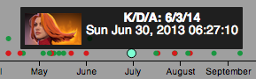
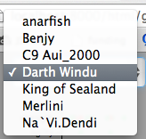
Clicking colorbind mode changes the coloring from red/green to orange/purple.
Hovering on a game brings up the time of the game, hero played, and Kills/Deaths/Assists Ratio.
User Selection Dropdown

Slide 46
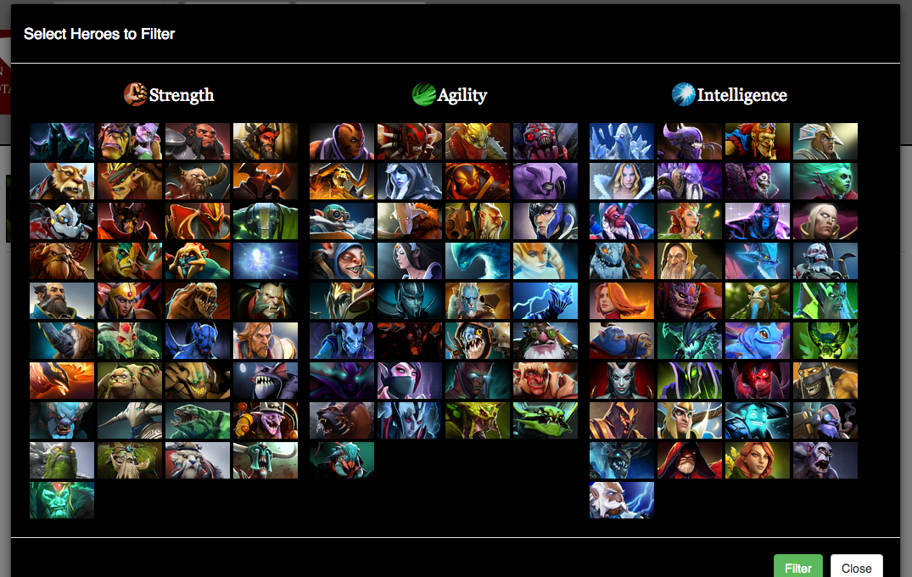
Select an attribute to select all heroes in that group
Select an individual hero to filter to that hero only
Filter
Close

Slide 47
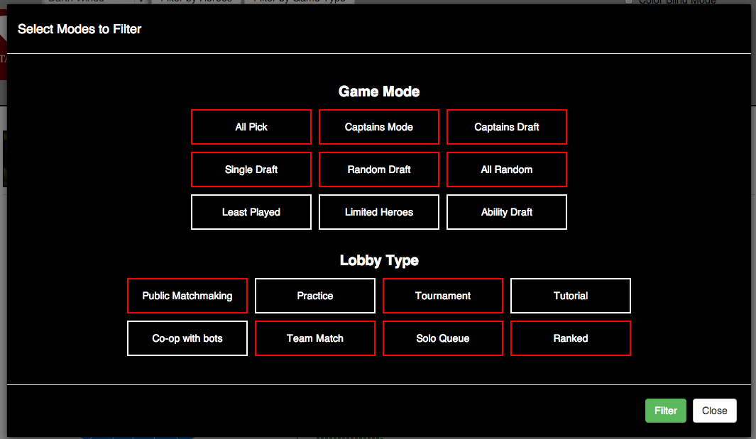
White means unselected. This is the default selection.
Filter by lobby type
Select to filter by game mode
Filter
Close

Slide 48
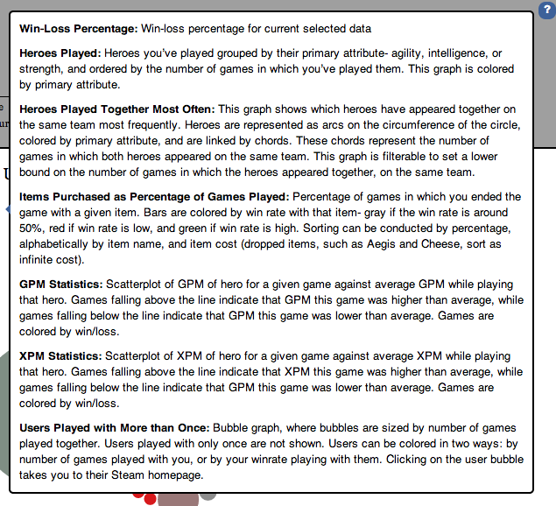
Question mark on click brings up graph descriptions for user.

Slide 49
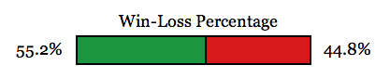
Win Loss Graph
Wins
Losses
Clicking colorbind mode changes the coloring from red/green to orange/purple.

Slide 50
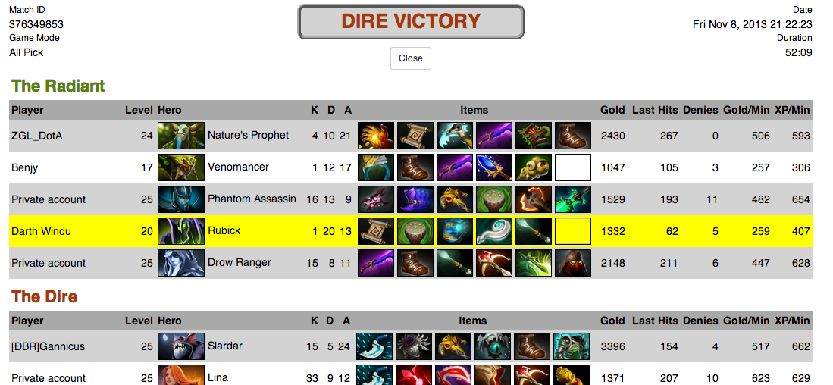
Records
Each record is displayed here, and will change based on the user’s data selection.
On click, brings up associated game
Click to close

Slide 51



Hero Sunburst Diagram
Hover to see hero name, number of games played, and items most commonly bought on that hero
Intelligence Heroes
Strength Heroes
Agility Heroes
Clicking on an element zooms in the graph. Here we see only agility heroes. Clicking on the center zoom out.
Coloring based on Dota Coloring

Slide 52

GPM/XPM Graphs
On click, brings up associated game.
On mouseover, changes the view to zoom in on dots.

Slide 53


On hover, brings up hero, GPM/XPM, and Average GPM/XPM on that hero
Selecting on game on one graph highlights the game on the other graph as well.

Slide 54

Hit here to clear the brush

Slide 55


Item Percent Bar Graph
Three ways to sort this graph
On hover, brings up item name, number of times bought, cost of item, winrate with the item, and heroes most purchased on

Slide 56




Hero Chord Diagram
Highlight Chord to see connection between heroes
Highlight edge to see hero name
Toggle to change filtering

Slide 57


User Bubble Diagram
On hover, see user name, number of games played together, and winrate together
On click, go to user’s steam profile, which opens in a new tab.

Slide 58


Select to toggle coloring
Brings up coloring legend
Clicking colorbind mode changes the coloring from red/green to orange/purple.

Slide 59



introJS
Benjy Levin
Motivation and Implementation
We felt that the most logical choice for introducing users to our visualization would be a guided walkthrough. This allows the user to be introduced to each graph in our visualization individually. This does not overwhelm the user the first time s/he uses our visualization, and at the same time, does not annoy accustomed users with pop-ups if they already know how to use the site. This is accomplished through using the introJS library, and placing a “Walkthrough” button on our splash screen, such that the user can choose to either jump straight into our visualization, or go to the visualization with a guided tour enabled.
Once the tour is completed, the user is notified that more help is always a click away.

Slide 60


Slide 61


Slide 62


